Slide 1
Types of LOOKUP() In Excel
Excel Presentation

Slide 2
Types of Excel LOOKUP function:
LOOKUP() Introduction
VLOOKUP()
HLOOKUP()
XLOOKUP()
INDEX()
MATCH()

Slide 3
LOOKUP()
The LOOKUP function in Excel can perform the simplest types of vertical and horizontal lookups.
=LOOKUP(lookup_value,lookup_vector,[result_vector])
Ex: =LOOKUP(1,A1:A5,B1:B5)
Ans : Dhiya
s.no | Name | Age | Result
1 | Dhiya | 23 | Dhiya
2 | Sindhu | 22 | Arun
3 | Dhilip | 24 | Sara
4 | Arun | 30 | Arun
5 | Sara | 28 | Sara

Slide 4
VLOOKUP()
VLOOKUP is to look up and retrieve information in a table organized vertically:
=VLOOKUP(lookup_value,table_array,column_index_num,[range_lookup])
Exact Match :
=VLOOKUP(3,A1:C6,2,FALSE)
Ans : Dhilip
Approximate Match :
=VLOOKUP(4.5,A1:C6,3,TRUE)
Ans : 177
s.no | name | mark | Result
1 | Dhiya | 100 | Dhilip
2 | Sindhu | 135 | 155
3 | Dhilip | 155 | Sindhu
4 | Arun | 177 | 177
5 | Sara | 188 | Dhilip

Slide 5
HLOOKUP()
HLOOKUP function in Excel is a sibling of the VLOOKUP function. The H in the HLOOKUP stands for “Horizontal” and hence it is often called Horizontal Lookup
=HLOOKUP(lookup_value, table_array, row_index_num, range_lookup
Exact Match
=HLOOKUP("Sindhu",A1:D3, 2, FALSE)
Ans : 25
Approximate Match:
=HLOOKUP(2.7, A1:D3,3,TRUE)
Ans : 28000
Name | Sindhu | 2 | 3
Age | 25 | 23 | 24
Salary | 15000 | 28000 | 25000

Slide 6
XLOOKUP()
The XLOOKUP function in Excel is a powerful and versatile lookup function that allows you to search for a value in a range or array and return a corresponding value in another range or array.
=XLOOKUP(lookup_value, lookup_array, return_array, [if_not_found], [match_mode], [search_mode])
=XLOOKUP(8,A1:A6,C1:C6,”Not Found”)
Ans : Not Found
=XLOOKUP(9,A1:A6,C1:C6)
Ans : #N/A
=XLOOKUP(4,A1:A6,C1:C6)
Ans : Sci
ROLL NO | NAME | SUBJECT | MARK
1 | A | Eng | 25
2 | B | Tam | 30
3 | C | Mat | 50
4 | D | Sci | 43
5 | E | Soc | 19

Slide 7
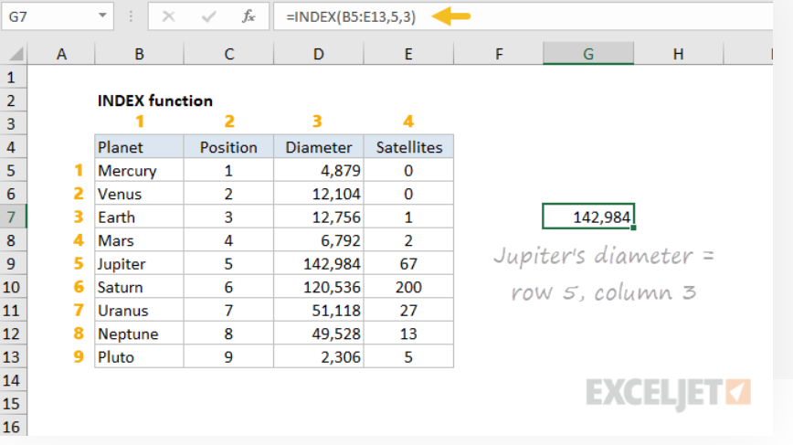
INDEX()
In Excel, the INDEX function returns a cell reference from within a given array or range
=INDEX(array,row_num,[col_num],[area_num])
=INDEX(B5:E13,5,3)
Ans : 142.984
=INDEX(B5:E13,8,2)
Ans : .................

Slide 8
MATCH()
MATCH is an Excel function used to locate the position of a lookup value in a row, column, or table. MATCH supports approximate and exact matching, and wildcards (* ?) for partial matches.
The MATCH function is used to determine the position of a value in a range or array.
=MATCH(lookup_value,lookup_array,[match_type])
match_type - [optional] 1 = exact or next smallest (default), 0 = exact match, -1 = exact or next largest.
Table I
=MATCH( 2,A52:A56,0) Ans : 2
=MATCH(2.9,A52:A56,1) Ans : 2
=MATCH(1.1,A52:A56,-1) Ans : #N/A
Table II
=MATCH( 2,A52:A56,0) Ans : 4
=MATCH(2.9,A52:A56,1) Ans : #N/A
=MATCH(3.9,A52:A56,-1) Ans : 2
ID | NAME | CORSE | MATCH
1 | AB | DADS | 2
2 | CD | DM | 2
3 | EF | FS | #N/A
4 | GH | CS | #N/A
5 | IJ | BI | #N/A
ID | NAME | CORSE | MATCH
5 | AB | DADS | 4
4 | CD | DM | #N/A
3 | EF | FS | 4
2 | GH | CS | 2
1 | IJ | BI | 1

Slide 9
MATCH TYPES
Match type | Behavior | Details
1 | Approximate | MATCH finds the largest value less than or equal to the lookup value. The lookup array must be sorted in ascending order.
0 | Exact | MATCH finds the first value equal to the lookup value. The lookup array does not need to be sorted.
-1 | Approximate | MATCH finds the smallest value greater than or equal to the lookup value. The lookup array must be sorted in descending order.

Slide 10
Thanking you

